Slide 1
Social Media Sentiment Analysis

Slide 2
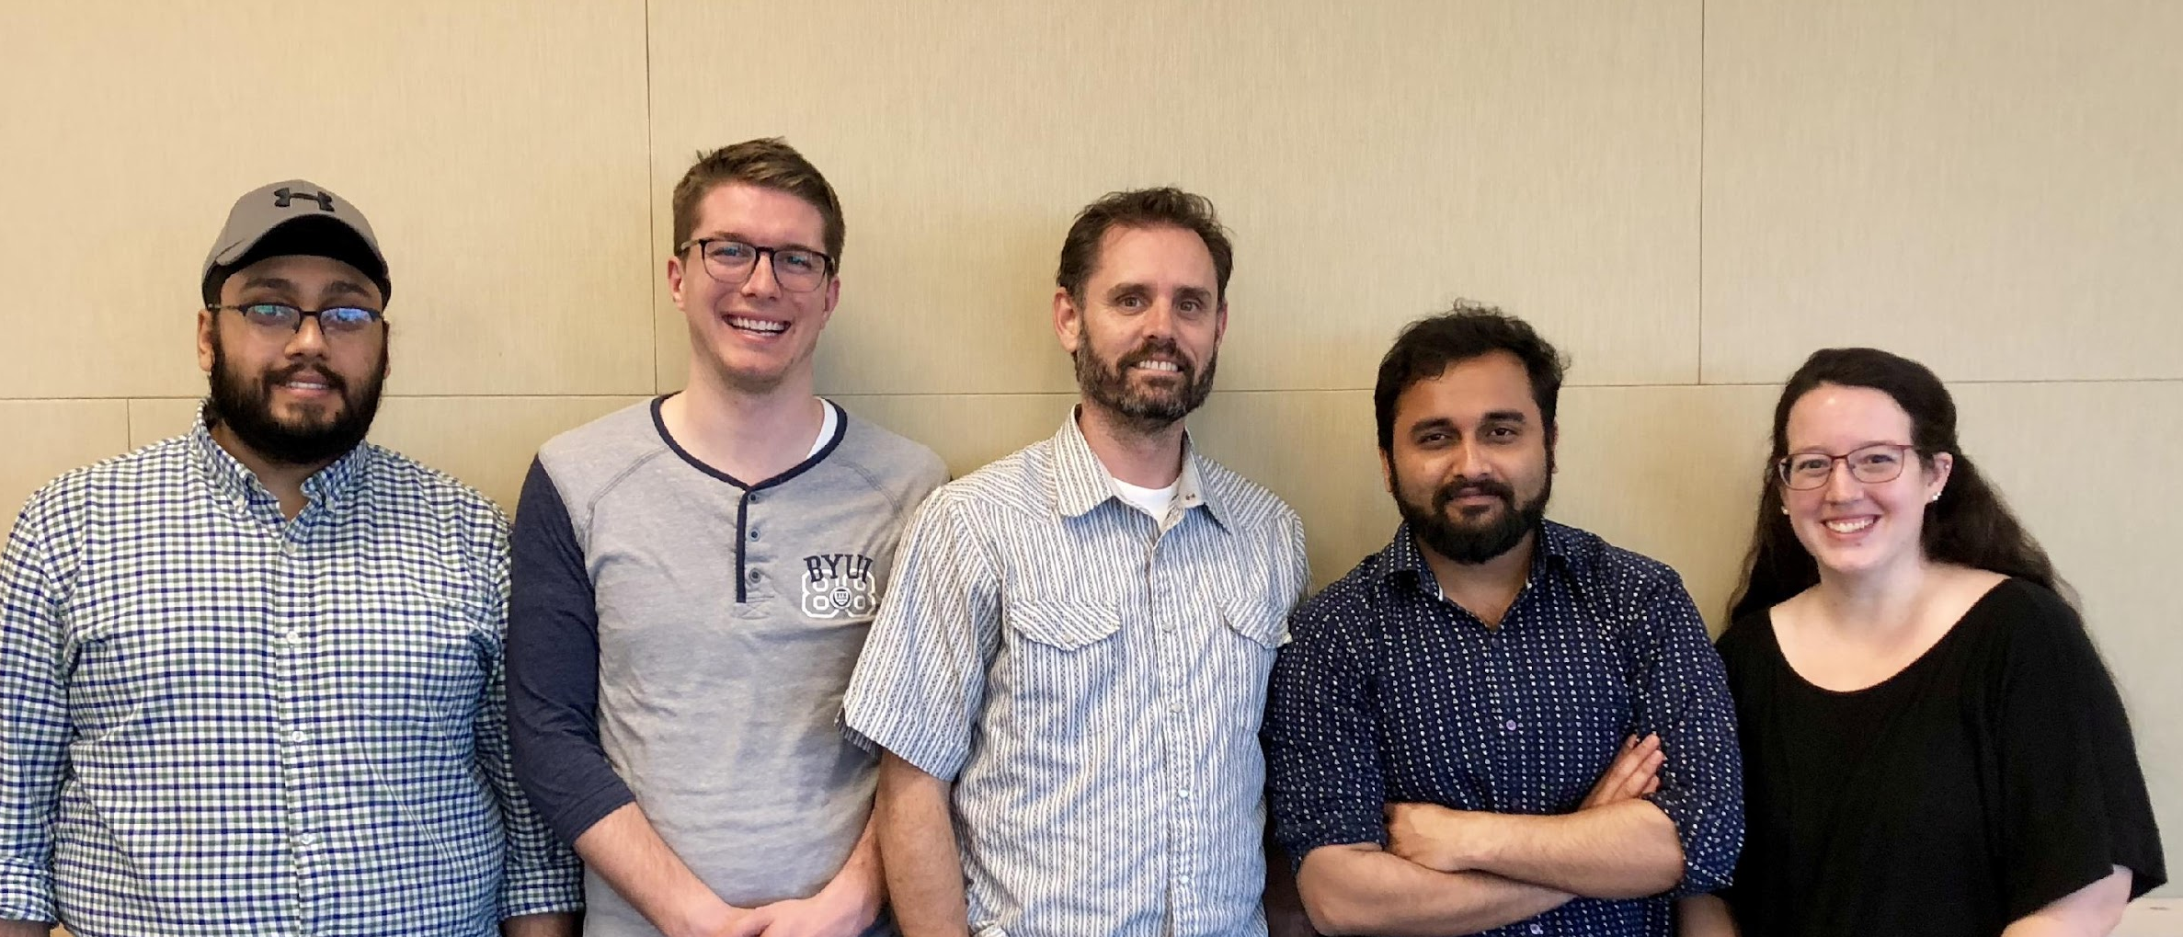
‹#›
TEAM

Slide 3
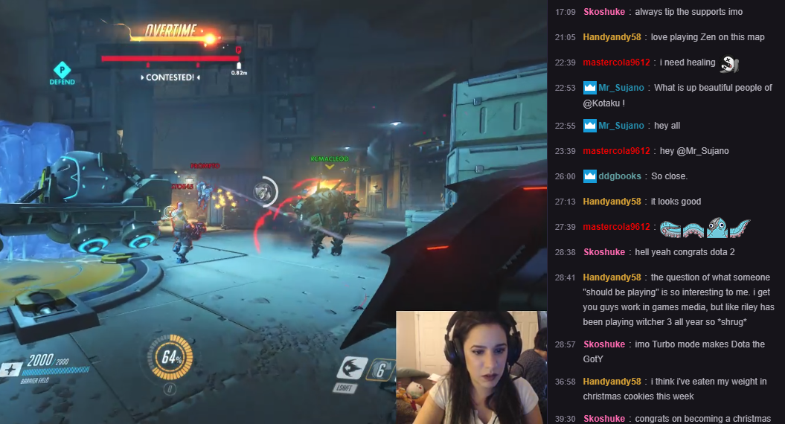
Twitch - a leading company in live video streaming

Slide 4

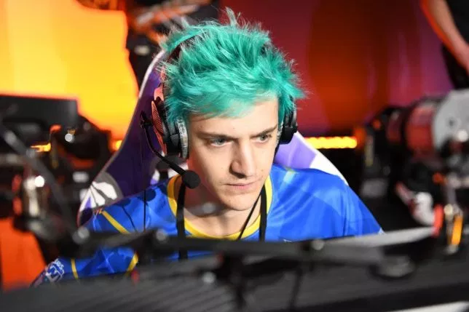
The Challenge
+
Streaming Outage
Angry Customers

Slide 5


The Challenge
=
Negative Social Media Sentiment

Slide 6
The Big Idea
Improve Twitch Operations Team response time to service downgrade/outages:
Perform Analysis
Identify relevant content
Post alert to Twitch team via Slack

Slide 7
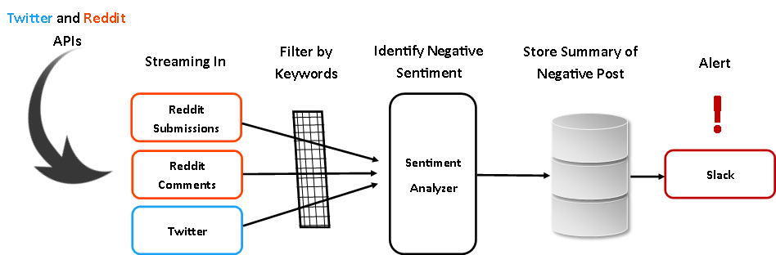
The Solution
Notes:
Twitter and Reddit have their API’s which are Tweepy and Praw respectively. They are used to extract tweets and Reddit posts from their websites. Then we built 3 completely automated bots that take data in continuously as soon as it is pushed in the respective social medium. Thus, problems related with scrapping and API limitations were resolved using real time processes.

Slide 8
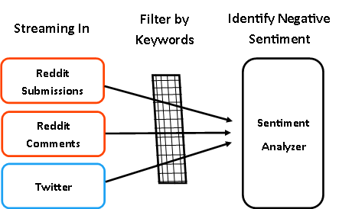
Data Manipulation and Score Assignment
Data Manipulation to gather information from the unstructured data
Filtering the extracted data
Calculation of semantic similarities between previously recorded alerts and incoming posts
Calculation of sentiment scores to remove posts with no complains in them
Notes:
automation_cron.py
Restart Bots
Dashboard
EC2 (Ubuntu, WSGI via Apache, Python, MySQL)
Pycharm, Sublime, dBeaver

Slide 9
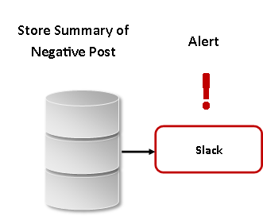
Pushing Alerts
Storing what we have learnt about the data
Creating a Notification Bot to handle complaints
Bot gather opinions every 15 minutes every 5 minutes
If threshold of 7 opinions is breached- Push an ALERT!!
Notes:
automation_cron.py
Restart Bots
Dashboard
EC2 (Ubuntu, WSGI via Apache, Python, MySQL)
Pycharm, Sublime, dBeaver

Slide 10
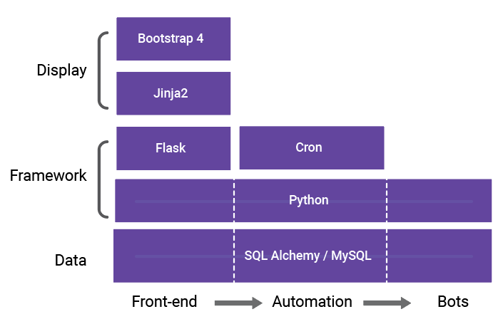
Environment
Server Technology Stack
Linux on EC2, Apache (WSGI), Python, MySQL
Google Charts
Automation
Cron driven system
Web front-end provides insight into bot processes
Notes:
automation_cron.py
Restart Bots
Dashboard
EC2 (Ubuntu, WSGI via Apache, Python, MySQL)
Pycharm, Sublime, dBeaver

Slide 11
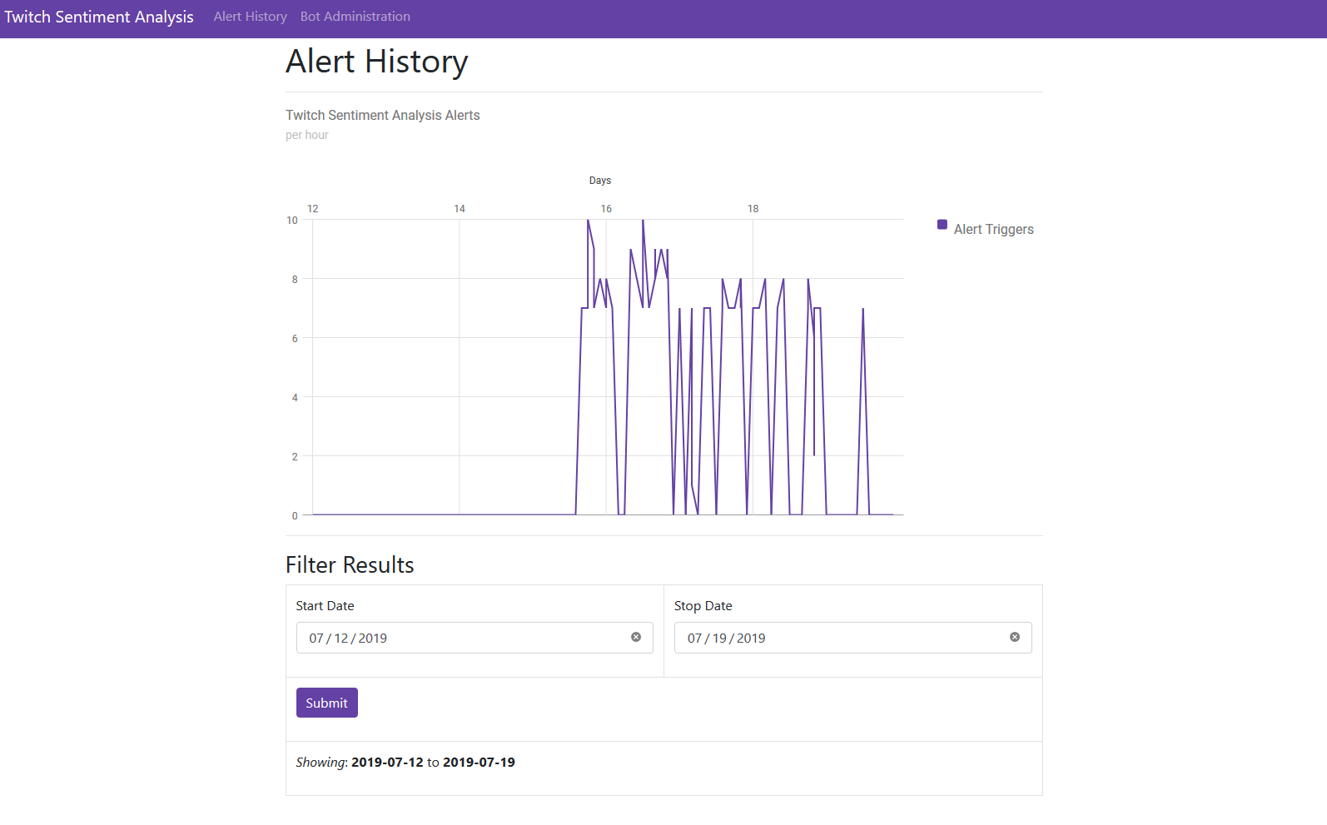

Slide 12
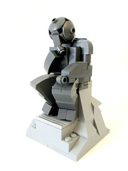
Challenges Along the Way
Should I pull? Or should I push?
API limitations
Flask environment
Cohesive team vision
Notes:
Explain the importance of data cleaning. Both Twitter and Reddit had extreme API limitations, while Reddit had the most limiting limitations. We could only capture a certain amount of tweets or Reddit The Reddit API limited us to only streaming the data after 100 archived posts, so we had to count to 100 posts then bring the data in. The Reddit process was also broken into two bots where we pulled in comments as well as submissions. The Flask environment was also challenging, because none of us had experience in front-end Python development. Flask is a micro web framework. This means it provides you with tools, libraries and technologies that allow you to build a web application. Team Vision was also difficult, because we all had different ideas to accomplish this goal, but we all had to have the same goal in mind for us to be successful in this project. We also had periods of us being siloed from one another as we worked on different parts of the project.

Slide 13
Keeping It Simple
Keywords are “tuneable”
No black-box
Over-alert
The time loop which runs the Slack notifier can be adjusted as per requirements
Notes:
Code is built in such a way where Twitch can take our keywords and make them stronger or adjust them so they aren’t locked into the specific keywords we have suggested for our codes. Our coding is super transparent with documentation that tells Twitch exactly how everything works. Twitch would have us over-alert than under-alert. They want to make sure they capture everything, rather than capture only major significant events.

Slide 14
Lessons Learned
Communicate effectively early
Be careful what assumptions you make
Personal task management
A great experience - everyone on the Team was challenged in new ways.
Notes:
Learned that communication is effective
Started moving really well when we had task, could be accountable, responsibility.
Could have known API limitations as scraping
Most information was on scraping we learned that streaming is better.

Slide 15

Next Steps
A foundation-based project:
Building analyses
Building machine learning
Building reports/dashboards

Slide 16
Questions

